Slide 1
Machine Learning with MRS
Introducing new algorithms

Slide 2
Applications
Regression
Demand forecasting
Classification
Propensity modelling
Churn modelling
Outlier detection
Next best action
Clustering
Customer segmentation
Topic modelling
Price modelling
Discrete choice analysis
Face detection
Image classification
Risk analytics
Real estate appraisal

Slide 3

ScaleR - Parallelized, remote executing algorithms
Data step
Data import – Delimited, fixed, SAS, SPSS, OBDC
Variable creation & transformation
Recode variables
Factor variables
Missing value handling
Sort, merge, split
Aggregate by category (means, sums)
Statistical tests
Chi Square Test
Kendall Rank Correlation
Fisher’s Exact Test
Student’s t-Test
Simulation
Simulation (e.g., Monte Carlo)
Parallel random number generation
Cluster analysis
K-Means
Sampling
Subsample (observations & variables)
Random sampling
Descriptive statistics
Min/max, mean, median (approx.)
Quantiles (approx.)
Standard deviation
Variance
Correlation
Covariance
Sum of squares (cross-product matrix for set variables)
Pairwise cross tabs
Risk ratio & odds ratio
Cross-tabulation of data (standard tables & long form)
Marginal summaries of cross tabulations
Classification
Decision trees
Decision forests
Gradient-boosted decision trees
Naïve Bayes
Predictive models
Sum of squares (cross-product matrix for set variables)
Multiple linear regression
Generalized linear models (GLM) exponential family distributions: binomial, Gaussian, inverse Gaussian, Poisson, Tweedie. Standard link functions: cauchit, identity, log, logit, probit. User defined distributions & link functions.
Covariance & correlation matrices
Logistic regression
Classification & regression trees
Predictions/scoring for models
Residuals for all models
Custom parallelization
PEMA-R API
rxDataStep
rxExec

Slide 4
Available Algorithms in RevoScaleR
Linear regression (rxLinMod)
Generalized linear models (rxLogit, rxGLM)
Decision trees (rxDTree)
Gradient boosted decision trees (rxBTree)
Decision forests (rxDForest)
K-means (rxKmeans)
Naïve Bayes (rxNaiveBayes)
What about SVMs? Neural networks? ☹ RML FTW ! ☺

Slide 5
Scalable R + World Class ML
NDA
Microsoft R Server
Connected
Scalable
Distributed
TLC
Fast, Scalable Learners
Battle-tested
State of the art
+
Notes:
Today we bring you RML – a new machine learning package for R. This product is a joint project between the Microsoft R Server and TLC teams. We’re really excited to be working with the MRS team. MRS is a great product which brings you scalable, distributed and integrated R. TLC brings you state-on-art, battle-tested machine learning algorithms.

Slide 6
Vision
NDA
Simpler
Easy to use
Cross-platform - Windows, Linux, Hadoop/Spark
SQL Server Integration
1
2
3
Better
More accurate out of the box
Battle-tested Algorithms
Rich functionality – text and high-dimensional
🏆
Faster
Highly performant trainers and transforms
Scale up and scale out
Streaming support for unlimited data size
🏃
Notes:
The vision for RML is simple – make machine learning on R simpler, better and faster::
Make ML in R simpler – available on multiple OSes and SQL server
Make ML in R better – bring high-accuracy learners and transforms for text and large data
Make ML in R faster – bringing multi-threaded and distributed learners that can scale up and scale out, and stream on unlimited data.

Slide 7
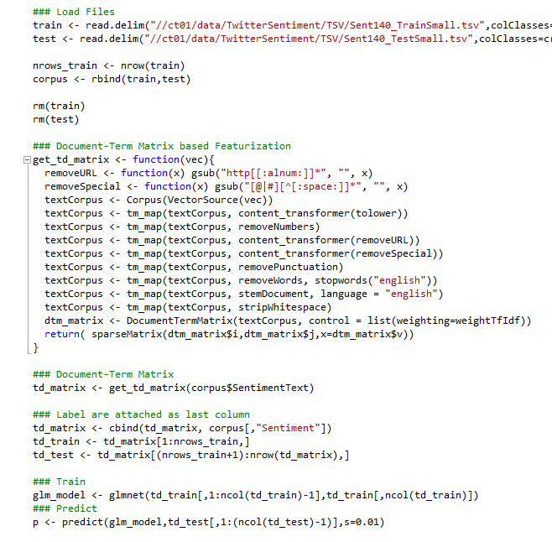
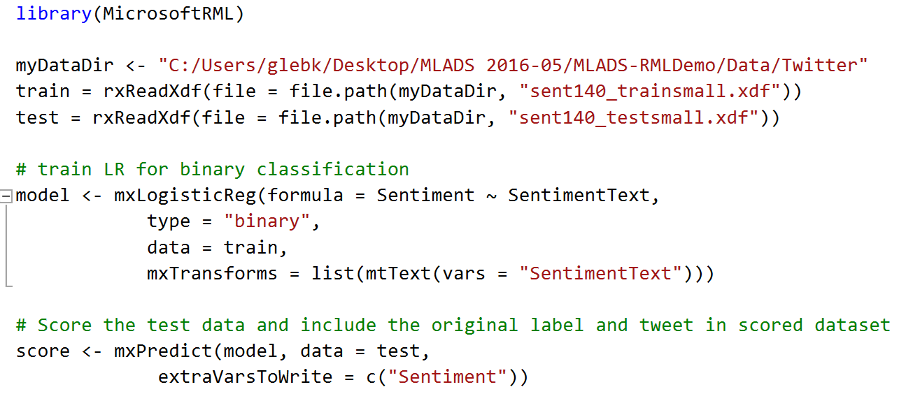
tm Package
NDA
RML Package
Notes:
To make this concrete, we asked a data scientist on our partner team to create experiments on a standard Twitter sentiment benchmark, Compared RML to CRAN R with the tm package

Slide 8
RML vs. R: Text Featurization (Twitter)
NDA
RML
tm
9x
Less lines of code
Simpler
Lines of Code
4
35
1
2
3
10%
More Accurate
Better
AUC
0.88
0.79
🏆
>30x
Faster Training Time
Faster
Training Time
1.3mins
50mins
🏃
Notes:
RML allows R developers
Writing 9 times less lines of code
Obtain a solution that’s 10% more accurate
In 30x less training time

Slide 9
Learners (algorithms)
NDA
Learner | Function | Strength | Learning tasks supported | Sample Applications
Deep Neural Network | rxNeuralNet | Supports custom, multi-layer network topology with filtered, convolutional, and pooling bundles | Binary classification Multi-class classification Regression | Bing Ads Click Prediction ($50M per year revenue gain)
Logistic regression | rxLogisticReg | L1, L2 regularization | Binary classification Multi-class classification. | Classifying user feedback
One-class SVM | rxOneClassVM | Easy to train learner for anomaly detection | Anomaly Detection | Fraud detection
Fast Tree | rxFastTree | Boosted decision tree. Similar to XGBoost | Binary classification Regression | Used in >200k experiments internally in 2014 alone. One of the most popular and best performing learners.
Fast Forest | rxFastForest | state-of-the-art tree ensembles (Random Forest) | Binary classification Regression | Churn Prediction
Fast Linear (SDCA) | rxFastLinear | Speed, scalability and supports L1,L2 regularization | Binary classification, Regression | Outlook used for email spam filtering

Slide 10
Featurizers
NDA
Transform | Funtion Name | Description
Text | featurizeText() | produces a bag of counts of ngrams (sequences of consecutive words of length 1-n) in a given text. It offers language detection, tokenization, stopwords removing, text normalization and feature generation.
Categorical | categorical() | Builds a dictionary of categories and transforms each category into an indicator vector.
Categorical hash | categoricalHash() | converts the categorical value into an indicator array by hashing the value and using the hash as an index in the bag.
Word Bag | WordBag() | produces a bag of counts of ngrams (sequences of consecutive words of length 1-n) in a given text.
Word Hash Bag | WordhashBag() | produces a bag of counts of ngrams (sequences of consecutive words of length 1-n) in a given text.
Feature Selection | selectFeatures() | Selects a subset of features by count or mutual information for training

Slide 11
DEMO

